Slide 1
ToDo
Check whether fuzzers can find memory safety bugs in Rust programs
in an unsafe crate (claxon v0.4.1)
with various fuzz targets (refer to related papers)
in Most Download crates
Try afl.rs for stand-alone programs
Does fuzzers detects memory safety bugs that RUDRA cannot detect?
Compare bugs that fuzzers found and RUDRA found

Slide 2
Today’s Overview
Find Memory Bugs in claxon by Fuzzing
Target program
Fuzzing configurations
Fuzzing results
Find Memory Bugs in claxon by RUDRA

Slide 3
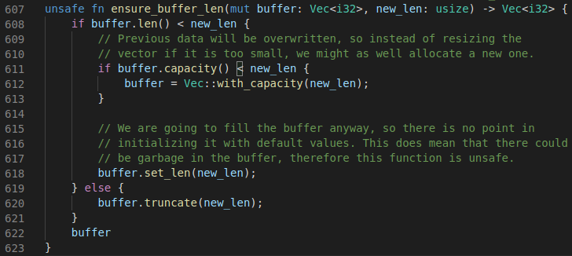
Target Program
claxon v0.4.1
FLAC decoder written in pure Rust
The version containing a memory safety bug (uninitialized read)
detected by afl with libdiffuzz (security-oriented alternative to Memory Sanitizer)
A function that induces uninitialized memory region in src/frame.rs of claxon crate

Slide 4
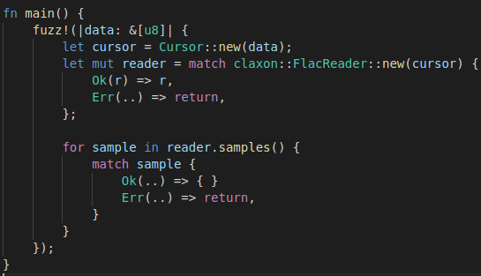
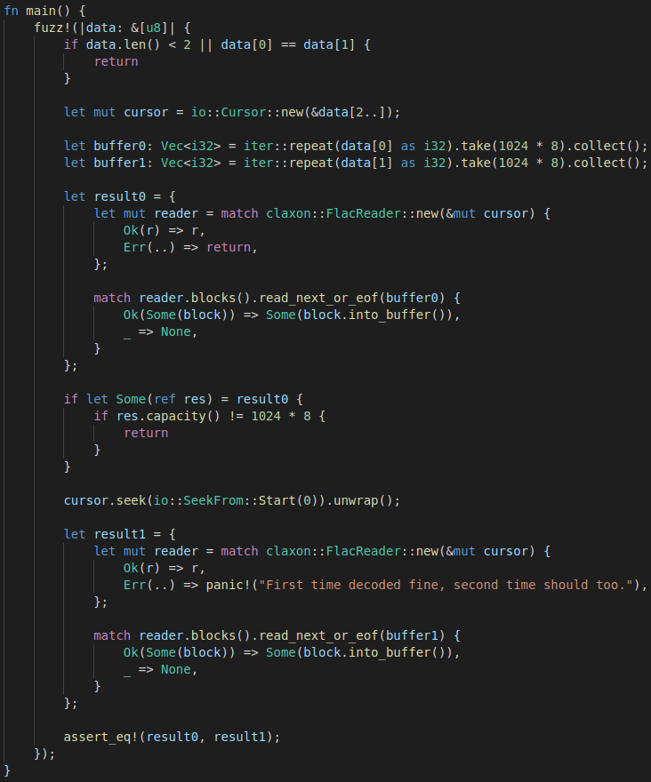
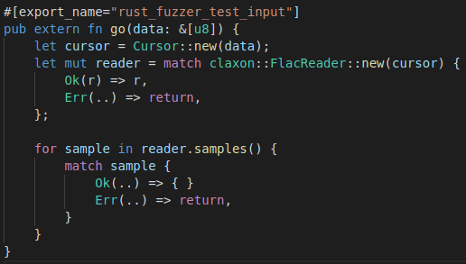
Fuzzing Configurations
afl.rs (AFL++)
with MemSanitizer and target 1 (F1)
with MemSanitizer and target 2 (F2)
with libdiffuzz and target 2 (F3)
cargo-fuzz (libfuzzer)
with MemSanitizer (F4)
afl.rs’ fuzzing target 1 for claxon
Two different runs with an input
cargo-fuzz’s fuzzing target for claxon
Check the difference btw the two runs
afl.rs’ fuzzing target 2 for claxon

Slide 5
Fuzzing Results
No bug found by F1~F4
F1: afl.rs w/ msan and target1
F2: afl.rs w/ msan and target2
F3: afl.rs w/ libdiffuzz and target2
F4: cargo-fuzz w/ msan
Config. | exec/sec | total inputs | edges found | # of edges | saved crashes
F1 | 25,071 | 2,979,366,630 | 7,489 | 194,306 | 0
F2 | 13,018 | 1,551,816,818 | 9,067 | 197,453 | 0
F3 | 34,827 | 4,091,572,469 | 1,965 | 7,676 | 0
F4 | 1,797 | 169,398,131 | 2,153 | - | 0

Slide 6
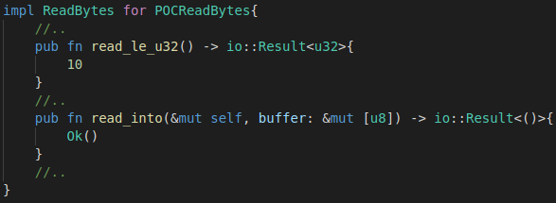
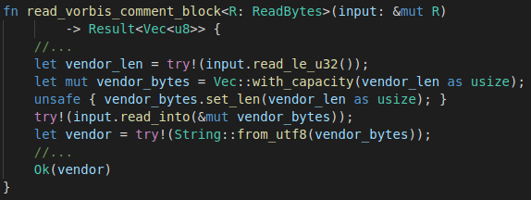
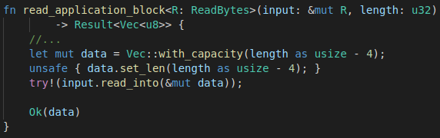
Find Memory Bugs in claxon by RUDRA
Take less than 2 seconds of running time
Cannot find the known bug
Find other two memory bugs
PoC implementation of ReadBytes triggering Bug1
vendor_len == 10
vendor_bytes :
a | c | e | 1 | e | b | # | @ | d | b
Bug1 found by RUDRA in claxon
uninitialized ten bytes
vendor_bytes.len() is remained as 0.
unsafely set vendor_bytes.len() as 10.
read_into do nothing; vecdor_bytes remains as uninitialized
vendor is “ace1eb#@db” which is converted from the uninitialized memory
Bug2 found by RUDRA in claxon

Slide 7
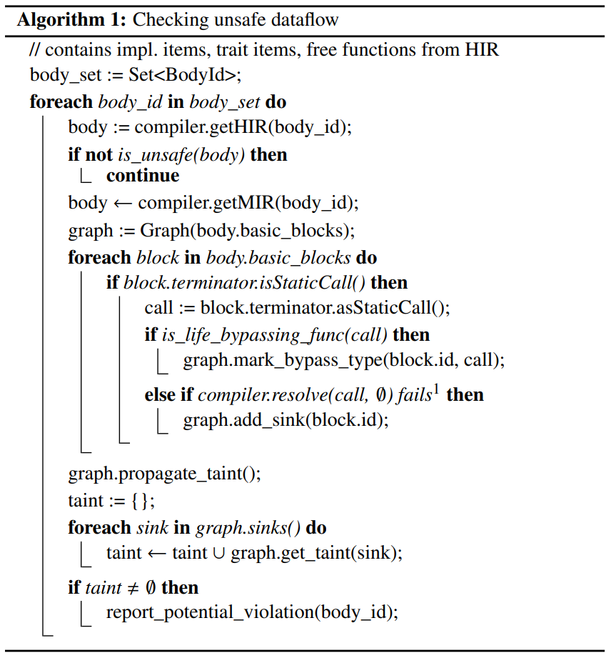
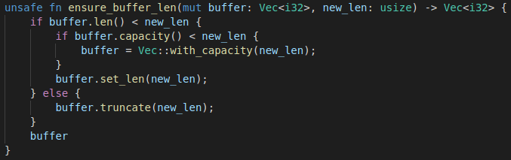
RUDRA Cannot Find the Known Bug
Because RUDRA’s analysis is bounded within a function.
analysis conducted
for each unsafe function
taint analysis on the control flow graph of the function
(does not deep into callee functions)
mark tainted location such as Vec::set_len(), however, the unsafe function in claxon (e.g., ensure_buffer_len, the function of the known bug) is not marked as tainted.
tainted!
Within the function, no propagation of the taint occur. However, the function itself is a type of set_len function.

Slide 8
Next ToDo
Check whether fuzzers can find memory safety bugs in Rust programs
in an unsafe crate (different versions of claxon)
with various fuzz targets
refer to a fuzz target generation technique for Rust: RULF: Rust Library Fuzzing via API Dependency Graph Traversal, ASE 2021
in Most Download crates
Try afl.rs for stand-alone programs
Does fuzzers detects memory safety bugs that RUDRA cannot detect?
Compare more bugs that fuzzers found and RUDRA found

Slide 10
b L: 23/4004 MS: 2 EraseBytes-ChangeBinInt-
#8674069668 REDUCE cov: 2468 ft: 11407 corp: 1231/559Kb exec/s: 26325 rss: 343Mb L: 3219/4004 MS: 3 ChangeBinInt-ChangeBit-EraseBytes-
#8720819393 REDUCE cov: 2468 ft: 11407 corp: 1231/559Kb exec/s: 26320 rss: 343Mb L: 60/4004 MS: 5 InsertByte-CopyPart-ShuffleBytes-EraseBytes-ChangeBinInt-
#8723470231 REDUCE cov: 2468 ft: 11407 corp: 1231/559Kb exec/s: 26320 rss: 343Mb L: 59/4004 MS: 3 ChangeBinInt-ChangeBinInt-EraseBytes-
#8743586691 REDUCE cov: 2468 ft: 11407 corp: 1231/559Kb exec/s: 26318 rss: 343Mb L: 54/4004 MS: 5 ChangeBit-ChangeASCIIInt-ChangeASCIIInt-ShuffleBytes-EraseBytes-
#8749515377 REDUCE cov: 2468 ft: 11407 corp: 1231/559Kb exec/s: 26317 rss: 343Mb L: 1399/4004 MS: 1 EraseBytes-
#8749772421 REDUCE cov: 2468 ft: 11407 corp: 1231/559Kb exec/s: 26317 rss: 343Mb L: 95/4004 MS: 4 CMP-CMP-EraseBytes-InsertByte- DE: "\x01\x00\x00\x00\x00\x00\x04\xeb"-"\xde\x04\x00\x00\x00\x00\x00\x00"-
#8758652483 REDUCE cov: 2468 ft: 11407 corp: 1231/559Kb exec/s: 26317 rss: 343Mb L: 74/4004 MS: 2 EraseBytes-ChangeBit-
#8761715494 REDUCE cov: 2468 ft: 11407 corp: 1231/559Kb exec/s: 26317 rss: 343Mb L: 1282/4004 MS: 1 EraseBytes-
#8768485422 REDUCE cov: 2468 ft: 11407 corp: 1231/559Kb exec/s: 26316 rss: 343Mb L: 53/4004 MS: 3 ChangeBinInt-CopyPart-EraseBytes-
#8771590789 REDUCE cov: 2468 ft: 11407 corp: 1231/559Kb exec/s: 26316 rss: 343Mb L: 524/4004 MS: 2 EraseBytes-CMP- DE: "shrink"-

Slide 11
ToDo
Fuzzing Rust Programs
Check whether fuzzers can find memory safety bugs
in an unsafe crates
in Most Download crates
Try afl.rs for stand-alone programs
Does fuzzers detects memory safety bugs that RUDRA cannot detect?
Compare bugs that fuzzers found and RUDRA found

Slide 12
Find Memory Safety Bugs in Rust Programs using Fuzzers
Target program and Fuzzing configuration
Initial Attempt and Results
Revised Fuzzing configuration
Fuzzing results

Slide 13
Target Programs
Claxon v0.4.1
FLAC decoder written in pure Rust
The version containing a memory safety bug (uninitialized read)
using afl with libdiffuzz (security-oriented alternative to Memory Sanitizer)
A function that induces uninitialized memory region in src/frame.rs of claxon crate

Slide 14
Fuzzing Configuration (Initial Attempt)
cargo-fuzz (libfuzzer)
with AddressSanitizer
More than 20 hours of fuzzing (more than 3 billion inputs)
Fuzz target and seed inputs provided by the crate
afl.rs (AFL++)
No sanitizer
Using claxon as a black-box library
More than 18 hours of fuzzing (more than 7 billion inputs)
Fuzz target and seed inputs provided by the crate
cargo-fuzz’s fuzzing target for claxon
afl.rs’ fuzzing target for claxon

Slide 15
Fuzzing Results (Initial Attempt)
No found crash for both cargo-fuzz and afl.rs
Results for cargo-fuzz
# inputs: 3,091,882,449
coverage: 2317 blocks
exec/s: 31,514
Results for afl.rs
# inputs: 7,344,333,757
coverage: 1953/7647
exec/s: 113,137
stability: 100%

Slide 16
Revise Fuzzing Configurations
To detect the uninitialized memory read!
Fuzzers can only detect crashes.
The uninitialized memory read may not induce a crash.
It is necessary to reveal the uninitialized memory read for fuzzers.
Use sanitizer!

Slide 17
Revised Fuzzing Configuration
afl.rs (AFL++)
Using libdiffuzz (security-oriented alternative to Memory Sanitizer)
Using claxon as 1) black-box library or 2) with source codes
Same fuzzing target and seed inputs
Run a program twice with different initialization value
Allocate memory
(p=malloc(sizeof(int)*6))
Use the allocated memory region
(p[0]=4; p[1]=5;)
Use uninitialized memory somewhere
(result = p[3])
1st run
p:
1 | 1 | 1 | 1 | 1 | 1
p:
4 | 5 | 1 | 1 | 1 | 1
result_1st == 1
2nd run
p:
2 | 2 | 2 | 2 | 2 | 2
p:
4 | 5 | 2 | 2 | 2 | 2
result_2nd == 2
Initialize allocated memory with 1 in the 1st run while 2 in the 2nd run
The differ results, a detected uninitialized memory read
An example to show how libdiffuzz finds uninitialized memory read

Slide 18
Fuzzing Results
No found crash for both afl.rs.1 and afl.rs.2
Results for afl.rs.1
More than 21 hours
# inputs: 6,042,425,693
coverage: 1955/7647
exec/s: 79,026
stability: 100%
Results for afl.rs.2
More than 17 hours
# inputs: 4,048,254,456
coverage: 1914/7717
exec/s: 66,073
stability: 100%

Slide 19
Discussion
How to improve fuzzing to detect the bug?
More valuable fuzz target
MemorySanitizer
Not yet found any reason why afl.rs (and its examples) does not use file inputs

Slide 20
Next ToDo
Fuzzing Rust Programs
Check whether fuzzers can find memory safety bugs
in claxon with MemorySanitizer
in Most Download crates
Try afl.rs for stand-alone programs
Does fuzzers detects memory safety bugs that RUDRA cannot detect?
Compare bugs that fuzzers found and RUDRA found

